Slide 1


Slide 2

Problem We Intend To Solve
Prepare an AI-based model for the most cost-effective sourcing of materials like steel, cement, tiles, pipes, valves, etc. along-with geotagging from ordering to supply.
A comprehensive definition of Problem statement:
To develop an AI-based procurement model for construction materials like steel, cement, tiles, pipes, and valves.
Utilize advanced algorithms to optimize sourcing decisions based on market data, supplier capabilities, and project needs.
To Implement geotagging technology for tracking shipments from order to delivery at the construction site and to analyze real-time transportation routes and schedules for cost minimization.
Provide user-friendly interface for project managers to access insights and track shipments.
The practical need for cost-effective sourcing of raw materials:
The prices of commodities like steel, cement, etc. are highly volatile.
Reduces the overall project cost.
Provides competitive advantage to the company.
Minimizes expenses and improves profitability.
Budget adherence which improves client satisfaction.
Mitigate the risk of financial losses associated with fluctuating prices.
Enhanced cash flow management.
Supports sustainability goals.
The need for geotagging:
Real-time tracking that enables better logistical planning.
Improved inventory management.
Provides an added layer of security for shipments.
Optimized route planning.
Improved supplier performance by monitoring supplier efficiency.
Efficient resource allocation by knowing the exact time of arrival.
Environmental impact reduction by efficient route planning.
Promotes transparency and accountability throughout the supply chain.
Generates valuable data that leads to data-driven decision-making.

Slide 3
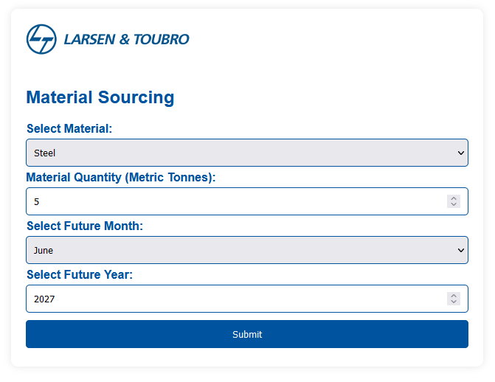
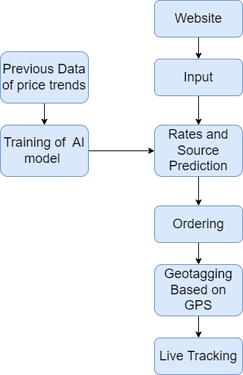
Our Approach: Sourcing Savy
This solution provides an user based interactive approach to the given problem statement of making an AI based Model to furnish the required predictions and implementation autonomous Geotagging system via GPS.
Enter the material: Steel
Enter the quantity needed (in metric tones): 5
Enter the future month (1-12): 6
Enter the future year: 2027
Predicted price of Steel for 6/2027: $101.44 per unit
Best Steel supplier: Supplier 5
Total Cost for 5.0 units from Supplier 5: $1392.88
Distance to Supplier 5: 366.44 kilometers
User End Prediction Console
Flowchart of our Approach
Prediction model output used by the console
Designed an interactive website tailored for user engagement.
Various inputs i.e. Material Type, Material Quantity, Future date are fed by the user.
After submission, the AI Model offers insights into the most economical sources of raw materials.
The AI Model is trained with the help of previous dataset of price trends.
Training is executed using Random Forest Regressor.
The Geotagging is based on GPS which calculates the ETA based on the destination coordinates.
Geotagging also enables constant monitoring.
The model takes two .csv files as input.
One of the input contains historical data of commodity prices (fetched from IMF).
Second input contains the Supplier’s Dataset.
The datasets are mapped and the prediction is based on Random Forest Regression training model.
The output provides the best suited supplier for the input future date along with the distance based on the coordinates.
Git-Hub Repository Link : For user end website & Backend training model

Slide 4
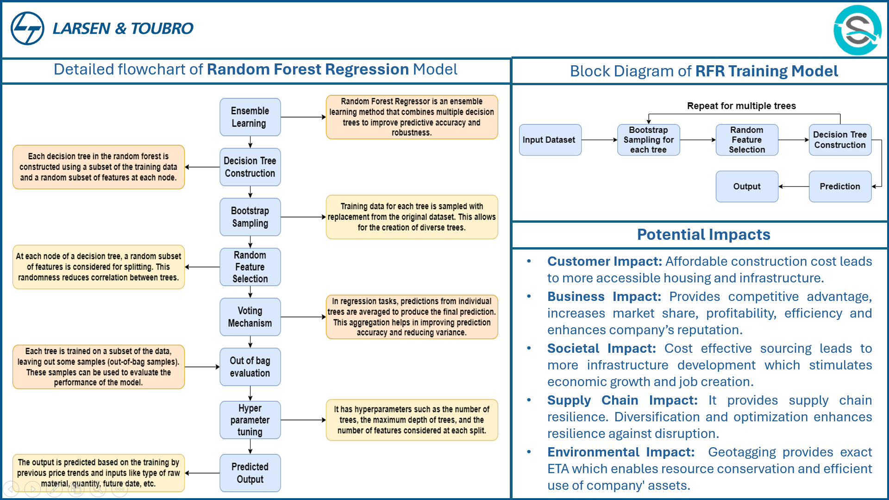

Slide 5


